Slide 1
LCC BLUEPRINT IMPLEMENTATION DOCUMENT
Insert logo here
< Zone / Partner Name>
< LCC Registration Number >
< Organization Name >
< Baseline Year – Project Year >

Slide 2

CONTENTS
EXECUTIVE SUMMARY
BACKGROUND
OUR LOW CARBON COMMITMENT
PROJECT INFORMATION
LOCATION MAP
COMMITTEE FORMATION
PARTNERS & STAKEHOLDERS
IMPLEMENTATION APPROACH
SELECTION OF ELEMENTS
IMPLEMENTATION STATUS
CO2 EMISSIONS RESULTS

Slide 3

EXECUTIVE SUMMARY

Slide 4
EXECUTIVE SUMMARY
Please write your executive summary here
MGTC/DC/REC/LCC-004 – REV: 1 - 09/06/2022

Slide 5
BACKGROUND

Slide 6
OUR LOW CARBON COMMITMENT
COMMITMENT STATEMENT
This is your promise to pursue low carbon initiatives to help tackle climate change
LOW CARBON 2030 VISION
Where do you see your city / organization in 2030 with regards to its low carbon performance
LOW CARBON MISSION
What are the key goals that you want to achieve to realise your vision and carry through your commitment
MGTC/DC/REC/LCC-004 – REV: 1 - 09/06/2022

Slide 7
PROJECT INFORMATION
State:
Assessment Year
2020
Selangor
Elements : Baseline Year
Local Authority:
Energy
2015
Majlis Bandaraya Shah Alam
City:
Water
2015
<INSERT LOCATION’S PHOTO>
City:
Shah Alam
Waste
2015
Zone Name:
Zone Name:
Mobility
2015
Pusat Bandar, Seksyen 14
LCC Serial No.:
Greeneries
2015
LCC-Z-B100-01-0001
<INSERT DESCRIPTION>
Organisation Name:
Majlis Bandaraya Shah Alam
Population Baseline:
8,957
Population Final:
8,957

Slide 8
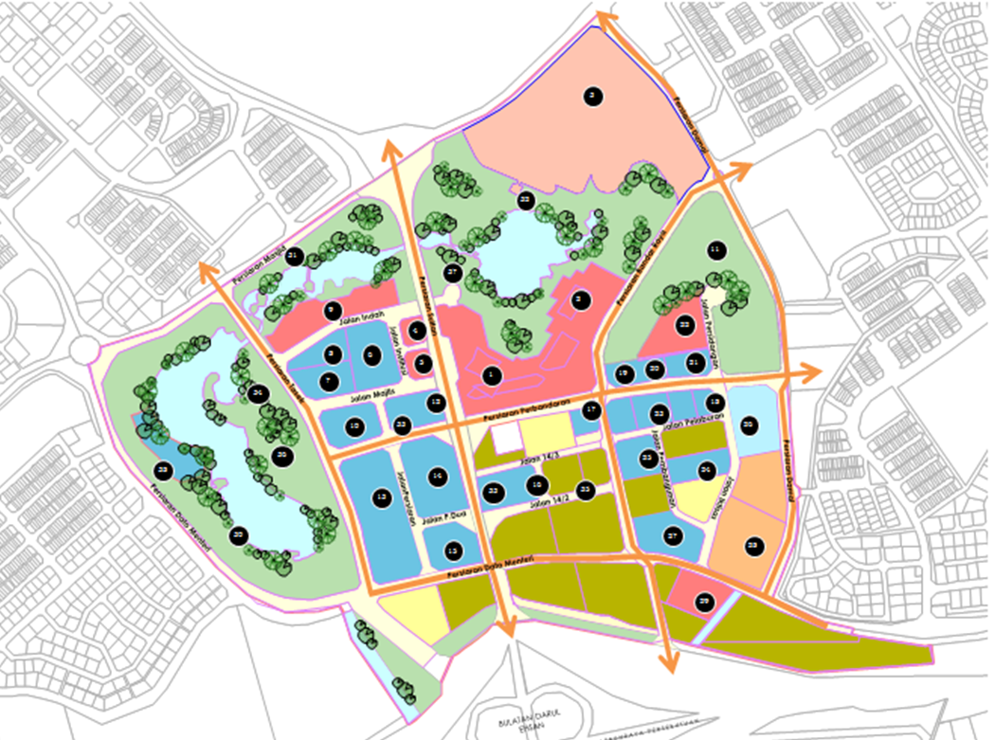
LOCATION MAP
PBT Area (ha):
29,030.00
Zone Area (ha):
159.89
Percentage Area
0.55%

Slide 9
LCC COMMITTEE / TASK FORCE
Display your LCC Committee / Task Force organisational chart and explain their key roles
ROLES
What are the roles of committee?
Explain their roles on low carbon implementation.
MGTC/DC/REC/LCC-004 – REV: 1 - 09/06/2022

Slide 10
PARTNERS & STAKEHOLDERS
PARTNERS
STAKEHOLDERS
List down the names or place the logo of your Partners.
Partners are those who provide data required to achieve your low carbon targets.
List down who (group of people or organization) that can affect or be affected by your low carbon objectives, actions and policies.
Communication, buy-in and involvement of stakeholders from the beginning of the project is vital for successful implementation of the initiatives and to ensure that everyone benefits from it.
MGTC/DC/REC/LCC-004 – REV: 1 - 09/06/2022

Slide 11
IMPLEMENTATION APPROACH

Slide 12
TARGETS – EMISSIONS REDUCTION / AVOIDED
The objective is to reduce usage of high emission sources and increase the adoption of low emissions sources
ENERGY
WATER
WASTE
MOBILITY
What are your energy efficiency and renewable energy targets?
Be clear on where it is going to be applied and set 3 targets; short, medium & long term. Also indicate baseline year.
E.g.
Short term (1-2 years):
5% Carbon emission reduction
Medium term (5 years/2025): 20%
Long Term (10 years/2030): 45%
What are your water efficiency and rainwater harvesting targets?
Be clear on where it is going to be applied and set 3 targets; short, medium & long term. Also indicate baseline year.
E.g.
Short term (1-2 years):
10% Carbon emission reduction
Medium term (5 years/2025): 25%
Long Term (10 years/2030): 45%
What are your waste reduction targets?
Be clear on where it is going to be applied and set 3 targets short, medium & long term. Also indicate baseline year.
E.g.
Short term (1-2 years):
5% Carbon emission reduction
Medium term (5 years/2025): 20%
Long Term (10 years/2030): 45%
What are your low carbon mobility targets?
Be clear on where it is going to be applied and set 3 targets; short, medium & long term. Also indicate baseline year.
E.g.
Short term (1-2 years):
5% Carbon emission reduction
Medium term (5 years/2025): 20%
Long Term (10 years/2030): 45%
MGTC/DC/REC/LCC-004 – REV: 1 - 09/06/2022

Slide 13
TARGETS – CARBON SEQUESTRATION
The objective is to maintain existing sequestration areas and gradually increase it over time
FOREST
LANDSCAPE
WATER BODIES
What are your targets for maintaining or increasing the forested area?
Be clear on where it is going to be applied and set 3 targets; short, medium & long term. Also indicate baseline year.
E.g:
Maintain or increase forest coverage area as compared to baseline year
What are your targets for maintaining or increasing the greenspace area?
Be clear on where it is going to be applied and set 3 targets; short, medium & long term. Also indicate baseline year.
E.g:
To increase green area/spaces, urban forest and number of trees
Short term: 3% increase
Medium term: 10%
Long term: 20%
What are your targets for maintaining or increasing the water bodies area?
Be clear on where it is going to be applied and set 3 targets; short, medium & long term. Also indicate baseline year.
E.g:
Maintain or increase water bodies area as compared to baseline year
MGTC/DC/REC/LCC-004 – REV: 1 - 09/06/2022

Slide 14
Strategies / Actions
<Please write your strategies & actions here>
MGTC/DC/REC/LCC-004 – REV: 1 - 09/06/2022

Slide 15
IMPLEMENTATION STATUS

Slide 16
Status of Implementation
Strategies |  | Actions |  | Means of verification | Target Year | Responsibility | Status
S1 | Development within defined urban footprint | T1 | Committing/Approving within defined urban footprint development | DO approval |  |  | On going/Completed
S2 | Infill development | T2 | Locating site in an existing built area/within currently developed area | DO approval
S3 | Development projects within transit nodes and corridor | T3 | Providing retail activities of public housing within transit corridor | DO approval
S4 | Brownfield and Grey field redevelopment | T4 | Providing incentive for brownfield and greyfield development
S5 | Hill slope development | T5 | Restore slope areas with native plants or noninvasive adapted plan | DOE/JKR Report
sample
MGTC/DC/REC/LCC-004 – REV: 1 - 09/06/2022

Slide 17
CARBON EMISSIONS RESULT

Slide 18
CO2 RESULTS
Element | Total Carbon Emissions |  | Reduction Achieved |  | Diamond Level
 | 2015 (B) tCO₂/yr | 2018 (A) tCO₂/yr | (B-A) tCO₂/yr | %
Energy
Water
Waste
Mobility
Total Emissions
Element | Total Carbon Sequestrations |  | Sequestration Increased |  | Diamond Level
 | 2015 (B) tCO₂/yr | 2018 (A) tCO₂/yr | (A-B) tCO₂/yr | %
Greenery & Water Bodies
Total Sequestration
MGTC/DC/REC/LCC-004 – REV: 1 - 09/06/2022

Slide 19
APPENDIX

Slide 20
APPENDIX
Please append photos, report, summary of data etc
MGTC/DC/REC/LCC-004 – REV: 1 - 09/06/2022

